Slide 1
Comparing and Contrasting Machine Learning Tools
Edward Chen, Michael Cirrito,
Jainam Shah, Efthimios Vlahos
11/28/2022

Slide 2
Abstract
Does machine learning have a one size fits all technique? Does data coming in all different modalities make any difference? In this experimental study, several machine learning tools, more specifically classification tools, will be investigated. A gender classification dataset with two different data types, image and numerical, will be used to compare the performance of those classification tools. The efficiency of the features will be analyzed.

Slide 3
Related Works
[1] presented a comprehensive view on these machine learning algorithms that can be applied to enhance the intelligence and the capabilities of an application. The paper explained the principles of different machine learning techniques and their applicability in various real-world application domains. Based on the study, the challenges and potential research directions were also highlighted.
[2].A number of machine learning tools were discussed, as well as how they are applied to different tasks. The paper gave a brief overview of those machine learning tools and their key features. Those tools that can be used to solve real-world problems were also presented. Different parameters and highlights features were examined. Specific frameworks that can be used with the processing platforms were provided as well.
[3].A variety of performance criteria to evaluate the learning methods were used. The authors noted that 1) it is possible that learning methods perform well on one metric but poorly on another, 2) performance by metric has found that calibration has significant impact on tool performance, 3) performance by model has found that there is no universally best learning algorithm. Even the best models perform poorly on some problems, and models that have poor average performance perform well on a few problems or metrics.

Slide 4
Problem Statement
Motivated by the aforementioned papers, in this study, we aim to find out which tools out of SVM (Support Vector Machines), Random Forests, and ANN (Artificial Neural Networks) work best for classification on different data modalities. More specifically, the goal is
1) To find the best performance of each classification tool on the dataset
2) To compare the performance of each machine learning tool to classify the same modality and the different modalities
3) To investigate the misclassification samples (e.g., is there any correlation between false positives and/or false negatives)
4) To analyze the efficiency of those features

Slide 5








Image Dataset
The image dataset is of cropped images of around 28,500 male and 28,500 female faces. Som sample images are shown below.

Slide 6
Numerical Dataset
The numerical dataset contains 7 descriptive features and a label for each of the subjects.
Features:
longhair - 1 if the subject has “long hair”, and 0 otherwise.
foreheadwidthcm - Width of the subject’s forehead in centimeters.
foreheadheightcm - Height of the subject’s forehead in centimeters.
nosewide - 1 if the subject has a “wide nose”, and 0 otherwise.
noselong - 1 if the subject has a “long nose”, and 0 otherwise.
lipsthin - 1 if the subject has “thin lips”, and 0 otherwise.
distancenosetoliplong - 1 if “long distance between nose and lips” and 0 otherwise.
Label:
gender - “Male” or “Female”.

Slide 7
Our Approach
We use grid search to find the best parameters for each of those classification tools.
Three performance metrics Accuracy, F1-score [6], and AUC-ROC curve [7] are used to gauge the comparison of the above classification tools.
We will focus on the analysis of misclassification and the analysis of the efficiency of those features after we have those test results.

Slide 8
Numerical Results
 |  | SVM-Poly | SVM-Sig | SVM-Rbf | ANN | Random Forest
Numerical Feature | Accuracy | 0.9770 | 0.9780 | 0.9790 |  | 0.9740
 | F-1 Score | 0.9766 | 0.9777 | 0.9790 |  | 0.9736
 | AUC/ROC | 0.9981 | 0.9981 | 0.9977 |  | 0.9943
Image | Accuracy | 0.9196 | 0.8778 | 0.8143 |  | 0.8646
 | F-1 Score | 0.9213 | 0.8800 | 0.8187 |  | 0.8684
 | AUC/ROC | 0.9696 | 0.9408 | 0.8788 |  | 0.9362

Slide 9
Numerical Results
 |  | SVM-Poly | SVM-Rbf | SVM-Sig | ANN | Random Forest
Numerical | Accuracy | 0.9770 | 0.9760
 | F1-Score | 0.9766
 | AUC/ROC | 0.9981
 | TIme (MS) | 62.13
Image | Accuracy | 0.9196
 | F1-Score | 0.9213
 | AUC/ROC | 0.9696
 | Time (Sec)

Slide 10
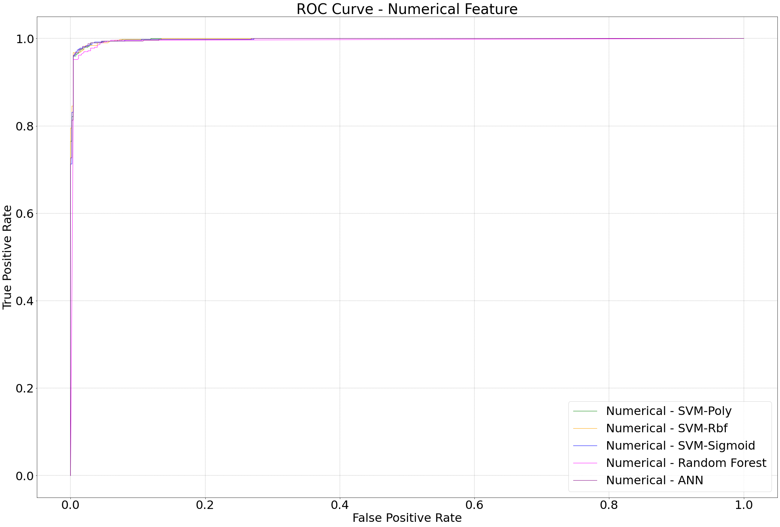
ROC Curves - Numerical Feature

Slide 11
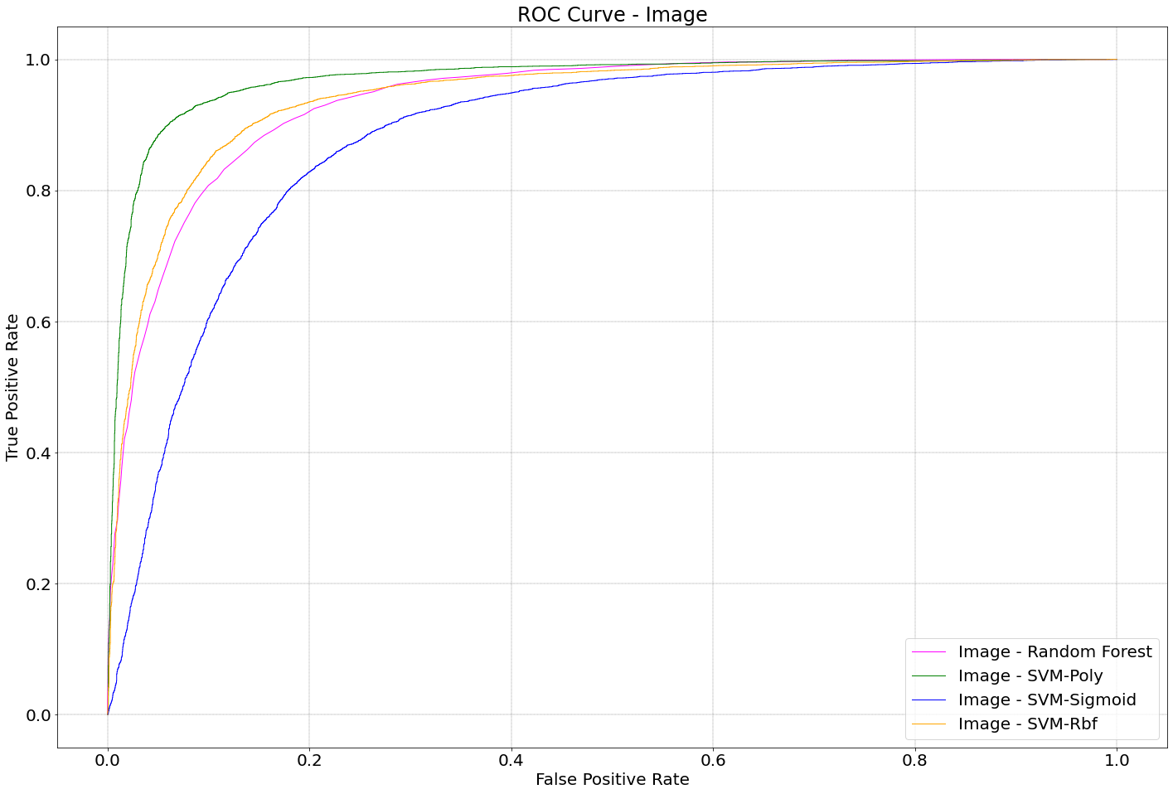
ROC Curves - Images

Slide 12
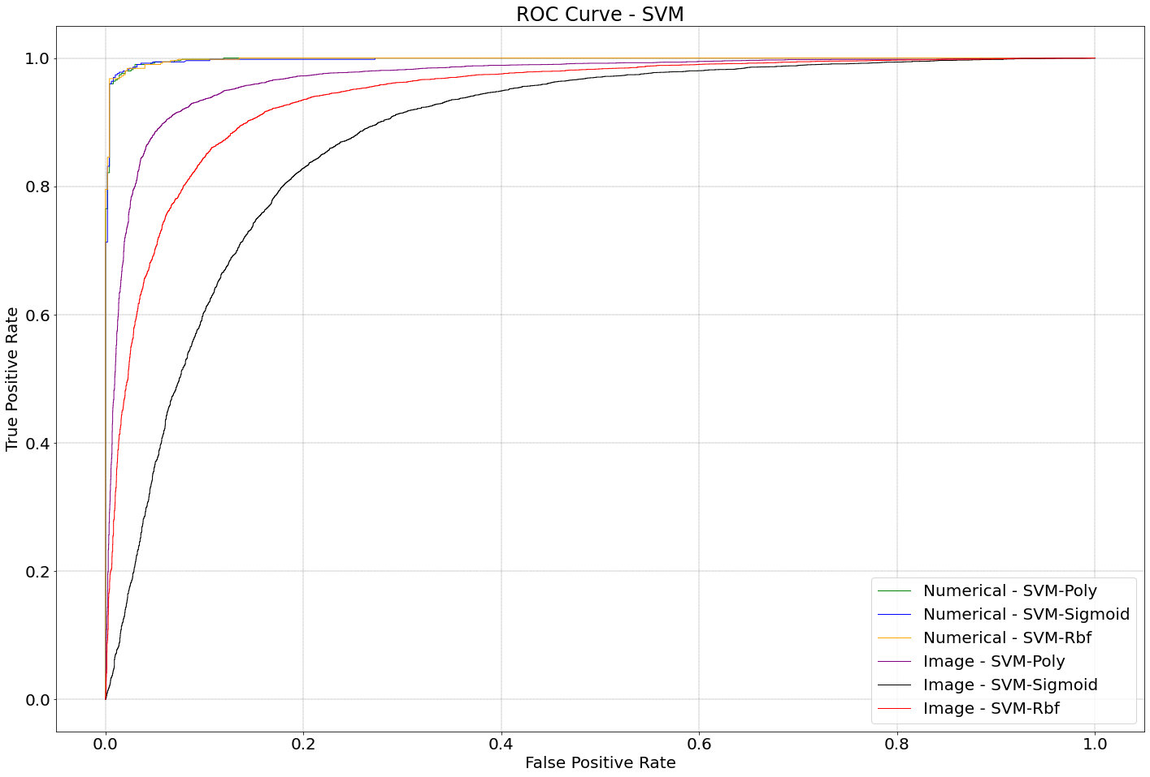
ROC Curves - SVM

Slide 13
ROC Curves - ANN

Slide 14
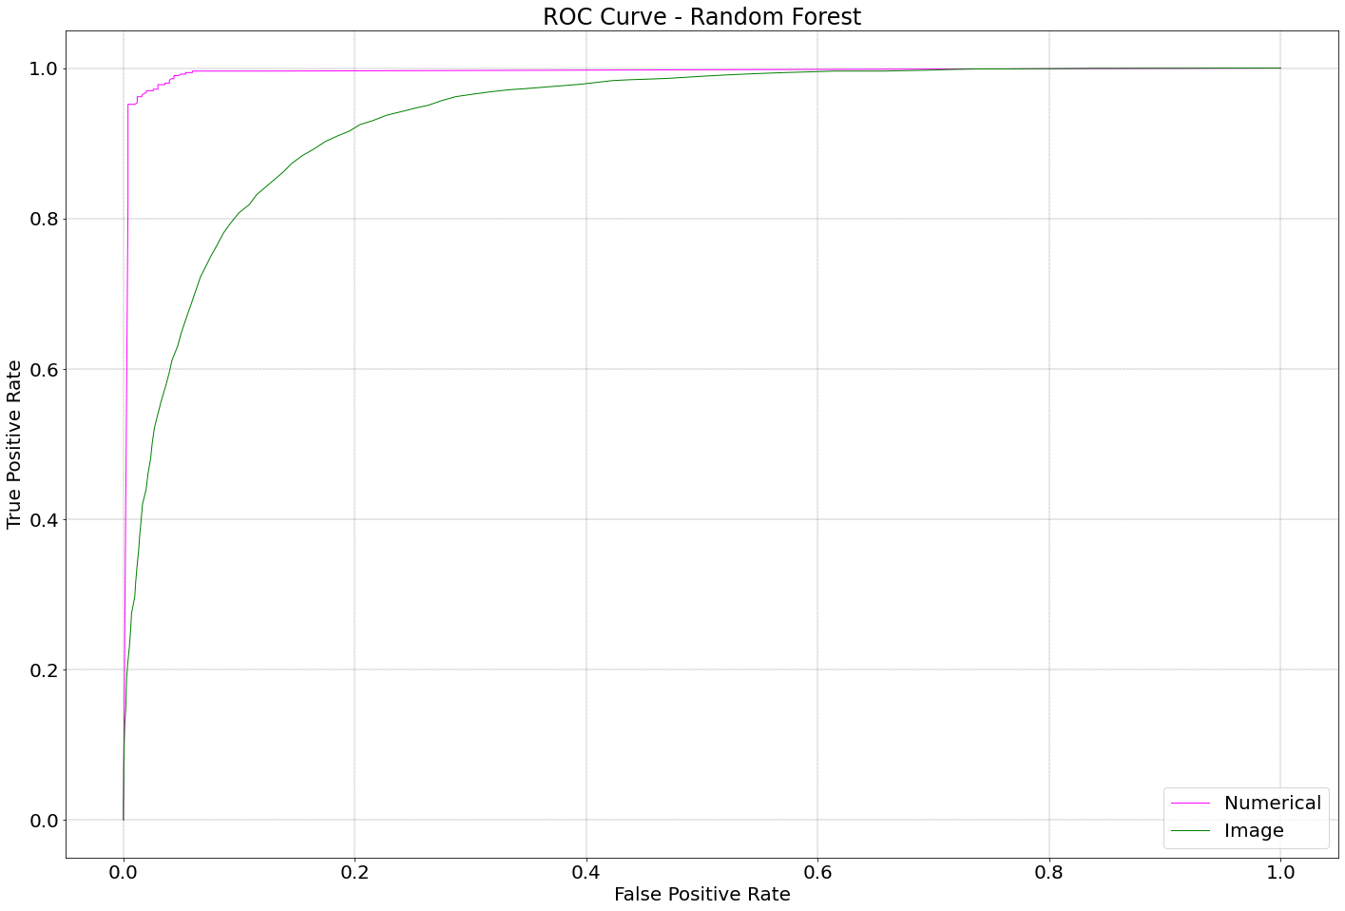
ROC Curves - Random Forest

Slide 15
Future Work
Result analysis.
Feature efficiency analysis.
Misclassification analysis.

Slide 16
References
[1]. I. H. Sarker, Machine Learning: Algorithms, Real-World Applications and Research Directions, SN Computer Science 2.3 (2021): 1-21.
[2]. S. Sarumathi, M. Vaishnavi, S. Geetha, P. Ranjetha, Comparative Analysis of Machine Learning Tools: A Review, International Journal of Computer and Information Engineering 15.6 (2021): 354-363.
[3]. R. Caruana, A. Niculescu-Mizil, An Empirical Comparison of Supervised Learning Algorithms, Proceedings of the 23rd International Conference on Machine Learning, Pittsburgh, PA, 2006.
[4]. https://www.kaggle.com/datasets/cashutosh/gender-classification-dataset
[5]. https://www.wikipedia.org
[6]. J Korstanje, The F1 score. https://towardsdatascience.com/the-f1-score-bec2bbc38aa6#::text=The% 20F1%20score%20is%20defined,when%20computing%20an%20average%20rate.
[7]. R Draelos, Measuring Performance: AUC (AUROC). https://glassboxmedicine.com/2019/02/23 /measuringperformance-auc-auroc/

